Slide 1
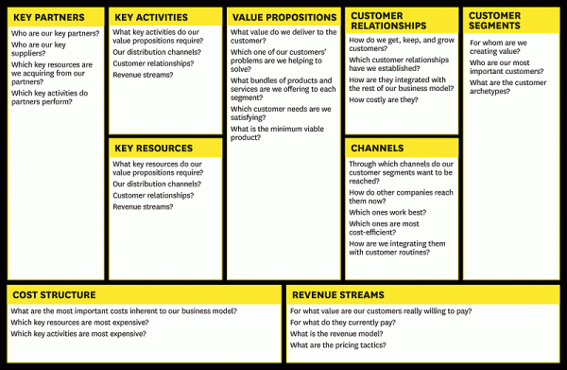
Business Model Canvas

