Slide 1

Business Plans and Entrepreneurship
Diane Eisenstat
Session 1
February 2 – March
Professor Jerry Tepfer, Ph.D., MBA
April 13 – June 03, 2015
Class 10

Slide 2
Business Plans and Entrepreneurship – Class 10
Pricing and Revenue Models
Financials
  Conserving Cash
  Start-Up costs, Identify the investment required
  Variable vs fixed operating costs
  Calculate profit
  Need for metrics
Team Presentations for Monday
  Pricing and Financials

Slide 3
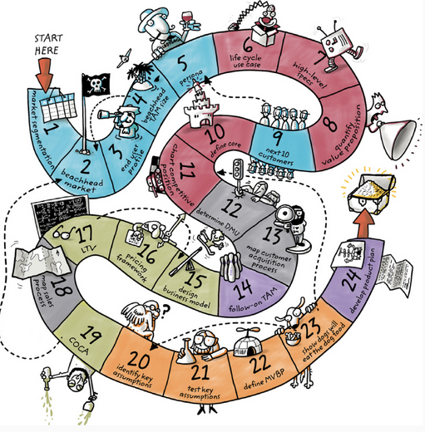
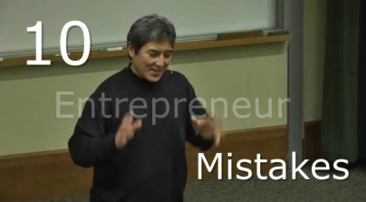
Homework for Today
In “Disciplined Entrepreneurship read
“How Do You Make Money Off Your Product?”
(Steps 15-17 & 19)
Read “Portland Freelancers’ Café”(pdf posted on Wikispaces ). Answer questions 1 to 3 and write up a few sentences on whether you think this company can succeed and why.
Keep on talking to customers!! Real feedback is better than a lot of market analysis based on secondary research.
Multiplying big numbers by 1%
Scaling too soon
Obsession with partnering
Pitching instead of prototyping
Using too many slides …
Doing things serially
Patents = Protection
“Disciplined Entrepreneurship: 24 Steps to a Successful Startup”
https://www.youtube.com/watch?v=HHjgK6p4nrw
Notes:
https://www.youtube.com/watch?v=HHjgK6p4nrw (8:05)

Slide 4
Portland Freelancers’ Café
1. Evaluate the economics-of-one-unit analysis that Amy and Steve conducted and then answer the following:
Amy and Steve assumed that, for every $6 in sales, $4 will come from selling computer-related services. Calculate what percentage of their total sales revenue per unit this $4 represents.
For every $2 in food and beverage sales, Amy and Steve assumed that their COGS per unit would be $1. (note: Other Variable Cost, Manager’s Commission not included in markup calculation) Calculate the markup percentage.
For every $4 in computer services sales, Amy and Steve assumed that their COGS per unit would be 25 cents. Calculate the markup percentage.
Notes:
$4.00/$6.00 x 100 = 66%
Markup/Wholesale x 100 = Markup Percentage
$1.00/$1.00 x 100 = 100%
$3.75/$.25 x 100 = 1500%

Slide 5
Portland Freelancers’ Café
2. List three things that Amy and Steve should have considered doing to adapt to the changes in the environment now that their customers no longer wanted to pay for Internet services, and expected the café to provide free wireless connections.
3. Evaluate their income statement for their first month of operations:
Is the café operating at a profit or a loss?
How many units above or below breakeven were sold?
Notes:
1. Offer printout and faxing services for customers to buy
2. Temporarily reduce advertising budget
Request temporary (three- to six-month) rent reduction from landlord
Increase food prices
Sell more food
Increase turnover
Take out less in salary as a loan or in exchange for equity
How many customers?
Failure to PIVOT
3) a) If they were to pay tax January net profit = $835
But they probably didn’t pay tax in 2011 net profit = $1,043
b) Breakeven = Fixed Costs/Gross Profit per Unit
January, sold 4,500 food units and 1,500 computer units
Unit = 1 food unit + 0.33 computer units = $3.55 x 0.33 + $0.90 x 1 = $2.08
$8,332/$2.08/unit = 3,999 units to break even
4,500 – 3,999 = 501 units sold above break even

Slide 6
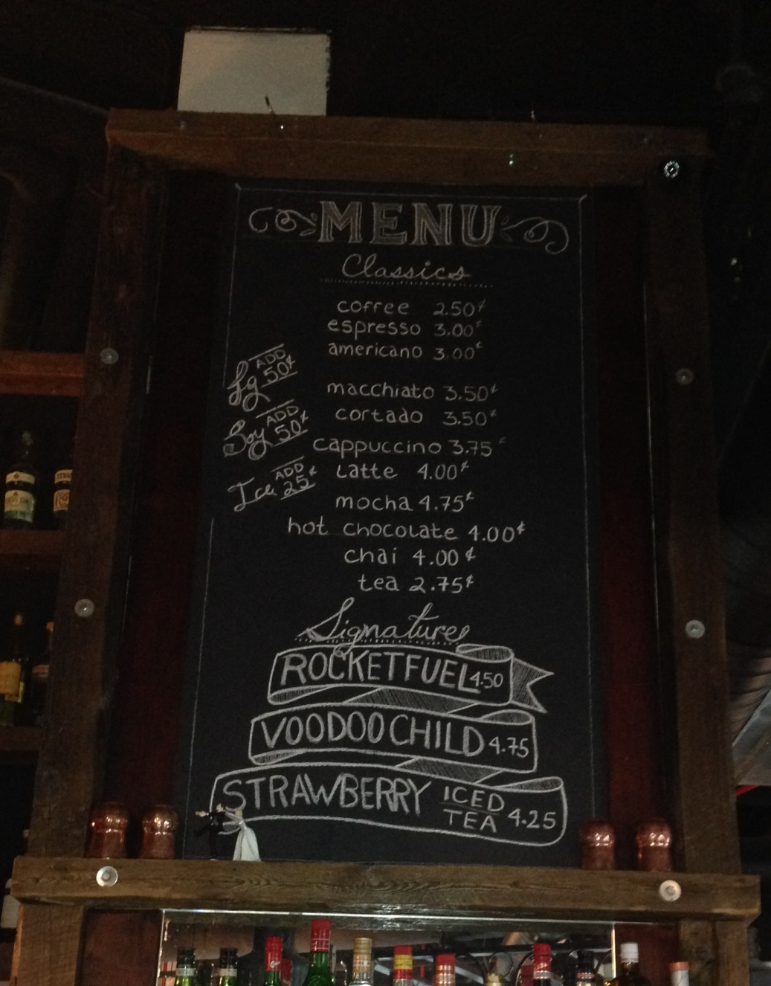
Portland Freelancers’ Café
Let’s look at the financials and important metrics.
No focus on customers, just units sold
Would breakeven with 25% increase in price of coffee
And coffee sales are growing

Slide 7
Homework – Portland Freelancer’s Cafe
What we learn from this case –
Small price increase can make the difference between loss and profitability
Price increases fall directly to the bottom line
What is the gross margin increase if you apply a 10% price increase on a product selling for $10 with a marginal cost of $6?
    Metrics are important, not benchmarking for expected number of customers, retained or new
    Know when to pivot!
Notes:
Current gross margin = $10 minus $6 = $4
10% increase means sell for $11, leading to a $5 gross margin. And increase of 25%

Slide 8

Pricing
Small differences can lead to a big change in your bottom line
Need to charge what customers are willing to pay guard against undercharging – tempting to assume that all customers are price sensitive
Pricing reflects your brand
Transparent – clear communication to the customer
Price for the characteristics of your market
“art rather than a science” – always benchmark and review stats
Notes:
to make means a 20% gross margin increase
Characteristics – if data manager, easy to get approvals: if sharing, price per enterprise.
Market segmentation – Those who get the most value for it or charge less for students.

Slide 9

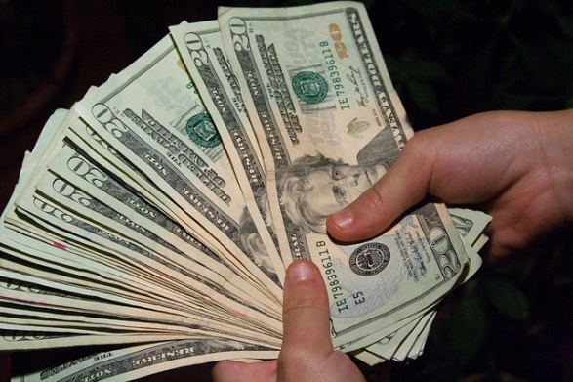
Fact: Pricing doesn’t always drive purchases
Analysis done by Experian using the Spring 2013 Simmons National Consumer Study, a comprehensive survey of 24,374 U.S. adults that measures consumer lifestyles, attitudes, brand preferences, media use and more.
http://www.experian.com/assets/marketing-services/white-papers/deal-seekers-2013.pdf
http://www.medialifemagazine.com/fact-pricing-doesnt-always-drive-purchases/

Slide 10
The Deal- Seeking Continuum
Deal Seeking
      Deal-Seeker Influentials (18%) – Always seeking the best deal anywhere whether online, offline or mobile
      Offline Deal Seekers (13%) – Also avid deal seekers, but use traditional media
      Deal Thrillers (14%) – Want the best dal but prefer their favorite stores
      Deal Takers – (12%) Don’t actively seek a deal they will take one if there is the opportunity
      Deal Indifferents – (34%) Lack shopping enthusiasm and unlikely to change behavior to chase a deal
      Deal Rejectors – (8%) They want convenience
Deal Rejecting
Notes:
Survey of 30,000 retail consumers

Slide 11
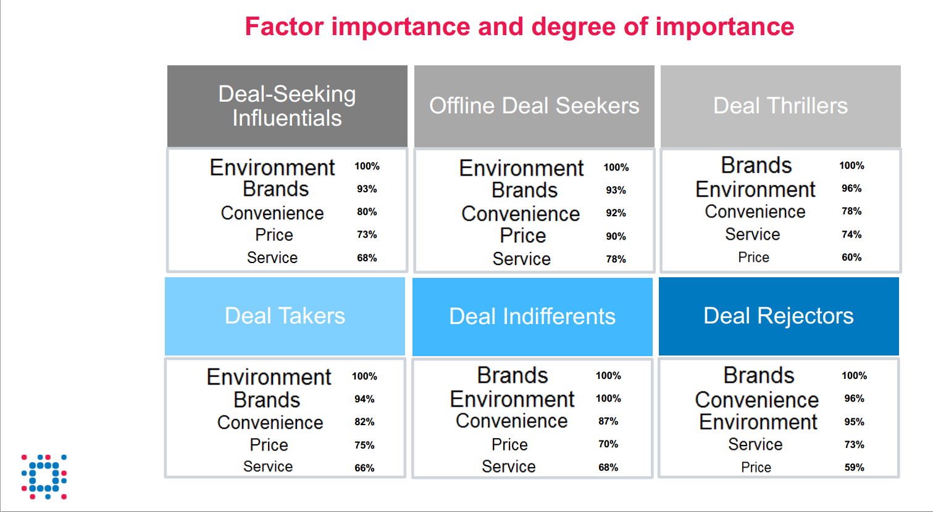
Price - important, but not the most important factor

Slide 12
The Deal- Seeking Continuum
Deal-Seeker Influentials (18%) – Relatively young and educated. Trust social media. Looking for the next best thing and deal. Expect and use coupons and promotions (Groupon)
Offline Deal Seekers (13%) – Oldest segment, more female and lower income. Most sensitive to price but least influenced by social media and less likely to compare prices.
Deal Thrillers (14%) – Want the best deal but still prefer their favorite stores. Less likely to be influenced by a coupon or sale. Usually male and deal influencers.
Deal Takers – (12%) Love a deal but really look to value, however, if offered a deal will check out a new store. More likely to pay attention to ratings and reviews.
Deal Indifferents – (34%) Lack shopping enthusiasm and unlikely to change behavior to chase a deal
Deal Rejectors – (8%) They want convenience, older, male and have money to spend. Deals are wasted on them.

Slide 13
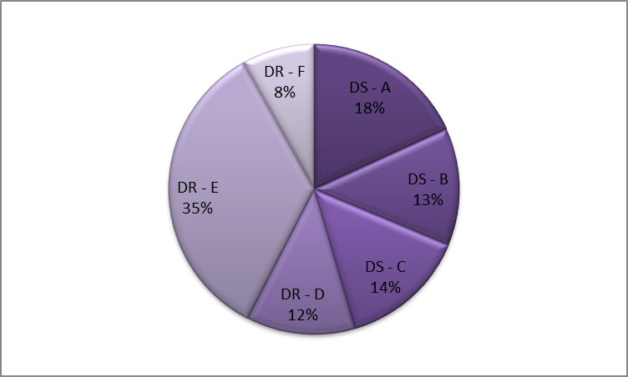

What does this mean?
Over half of those surveyed are not driven by price.
Why offer them discounted pricing? Price breaks don’t motivate people nearly as much as advertisers seem to think they do

Slide 14

Price is Not an Indication of Quality for Hotel Guests -
Price is Not an Indication of Quality for Hotel Guests - Reviews Are
Therefore hotels can vary price within reason to suit demand patterns without damaging quality perception of quality. However, all things being equal, consumers prefer to pay less.
Competing on price alone is not a winning strategy
Merely benchmarking against the competition’s price isn’t enough.
Reviews are preferred for evaluating a hotel purchase
Ratings influence quality and value perceptions. But consumers are much more reliant on reviews to determine the perceived quality and value of a hotel purchase. When review sentiment conflicts with ratings, consumers rely on the sentiment, ignoring the ratings.
Discounting poorly-rated properties doesn’t build perceived value
When reviews are negative and ratings are low, consumers perceive no difference in value between low and high price. Therefore lowering the price of a poorly-rated property will not create any additional value in the minds of the consumers. Managers should work on fixing the problem, rather than playing around with pricing.
http://www.hotelnewsresource.com/article72373.html (Link to this study)

Slide 15
Relationship between perception of quality and price
Customers approach a product with pre-conceived ideas of how it should be priced. A price significantly higher or lower than their expectation may provoke suspicion, either that the product is of a lower quality than they anticipated, or that the price has been unreasonably inflated.
Cakes of Deception
http://channel.nationalgeographic.com/channel/brain-games/videos/cakes-of-deception/
Notes:
well-known brand positioning legend concerning a British department store, whose marketing department was perplexed when an umbrella, priced at a very reasonably £10, failed to sell. A management consultant solved this problem with the somewhat counterintuitive suggestion of raising the price to £20, after which sales immediately increased. Customers seemed to find the £20 price tag a reassuring confirmation of the product’s quality, whereas the much lower original price had been grounds for suspicion.

Slide 16

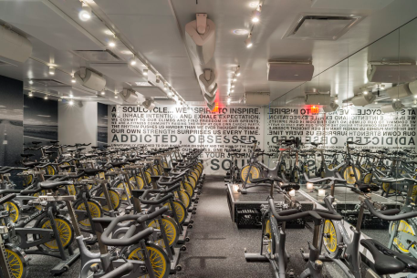
The Secret to SoulCycle's Success? Maintaining the Luxury
Why do you guys charge such a premium for classes?
Elizabeth: There is a luxury component to it. When people pay for something, there’s a certain commitment and a certain energy that they bring to it, and that elevates the whole [concept]. That’s where you start to feel the commitment.
Would you ever offer classes for a lower price?
Julie: We have never needed to do it and people value what they pay for.
http://www.racked.com/2015/3/4/8110647/soulcycle-elizabeth-cutler-julie-rice
Notes:
SoulCycle essentially invented luxury cycling. There were plenty of cycling options before they started, yet with a focus on their customer they were able to create a new market.

Slide 17
Pricing Strategies – Cost-Plus or Mark-up
A commonly used and easiest to calculate strategy
Price = Cost plus Profit Margin
Cost-plus pricing is often used on government contracts (cost-plus contracts), and has been criticized as promoting wasteful expenditure in the form of direct costs, indirect costs, and fixed costs whether related to the production and sale of the product or service or not. These costs are converted to per-unit costs for the product; then a predetermined percentage of these costs is added to provide a profit margin. (Often determining costs is not that easy)
Notes:
Such as Portlander’s Café example.

Slide 18
Pricing Strategies – Cost-Plus or Mark-up
Disadvantages
Fails to take marketing vision and market conditions into consideration
Leaves money on the table
Commodity Pricing – You don’t want to be there
Has nothing to do with your value and the need to communicate that value.

Slide 19
Pricing Strategies – Competition Based
Meet or beat the competition
It is common for service businesses to use a meet-or-beat-the-competition pricing strategy, which entails constantly matching or undercutting the prices of your competition.
Follow-the-Leader:
Similar to meet-or-beat-the-com-petition but with a particular competitor as the model for pricing. Typically, the leader is a dominant firm in the industry and controls a substantial portion of market share

Slide 20

Pricing Strategies – Meet or beat the competition
Disadvantages
Many of the same problems as cost-plus pricing your business isn’t differentiated from the competition.
At the mercy of your competitors
Notes:
Your cost structure may be different for reasons that add value to your product, but you won’t be able to capture that extra cost.

Slide 21
Pricing Strategies – Value Pricing
Most sustainable option
Pricing is based on the value a customer gets from your product
Not easy to calculate, may require customer segmentation and/or bundling
Often difficult for Sales to communicate
Requires analysis, metrics and listening to customer feedback
Notes:
We created different pricing for users based in cost rather than profit centers or not-for-profits.

Slide 22
Pricing Tactics – Penetration Pricing
Goal is to gain market share and involves offering a low price or discounts during the early stages of a product’s life cycle to gain market share.

Slide 23
Pricing Tactics – Penetration Pricing
Advantages –
Shortens time to market and to proof of concept
Can generate cash
Risks –
Difficult to lower a price point
Can run out of cash (remember pets.com)
Notes:
Case in the book about a medical devise where pricing was based on what insurance will pay

Slide 24
Pricing Tactics – Skimming
This is the opposite of penetration strategy as high prices are charged during the introductory stage—when the product is novel and has few competitors—to take early profits.
To be sustainable as a strategy need to constantly come out with new products

Slide 25
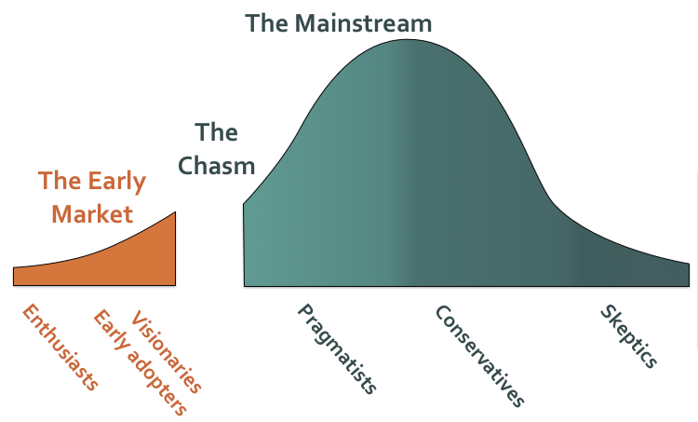
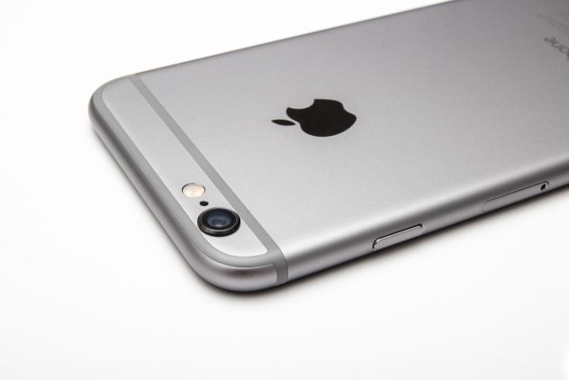
Pricing Tactics – Skimming
This strategy recognizes that competition and product maturity may erode the firm’s capacity to maintain the pricing later.
Especially with technology and certain fashion trends where value is higher for the early adopters.

Slide 26
        Pricing Tactics – Personalized & Variable
Personalized, (dynamic) pricing strategy is one in which a company charges a premium above the standard price for a product or service to certain customers, who will pay the extra cost.
Variable pricing strategy entails offering discounts, easier credit terms, and price concessions to certain customers as firms set different prices for a single product or service.
Consulting businesses
Be careful re transparency. Such pricing works only when products are not easily compared and customers are not likely to communicate with one another.
Notes:
More and more it is easier to compare prices and people don’t like to be in the dark about how they are charged. It is also hard to keep track of these strategies. A better way is through value pricing targeted to a market segment with a differentiated product (i.e. include extra customer service for higher priced offerings or take away something from lower priced offerings)

Slide 27
        Pricing Tactics – Prestige
High prices are set on products or services to send a message of premium quality.
For this to be effective in the long run, the product must fulfill the image and sustain it.
Notes:
In a way like Value pricing but this has to do with brand positioning more than figuring out how your customer values your product.

Slide 28
        Pricing Tactics – Price Lining
  Creating distinctive graded price levels for your merchandise .
  For example, Sears carries “good, better, best” product lines in its paint products, and prices them accordingly

Slide 29
Pricing Strategies
Pricing strategy are not a one-size-fits-all proposition. As you define the marketing strategy for your company, including your target market(s), competitive advantages, and overall marketing mix, a range of appropriate pricing strategies will emerge.
  The Decoy Effect
http://channel.nationalgeographic.com/channel/brain-games/videos/the-decoy-effect/
Perception of value
https://www.youtube.com/watch?v=_wxZFb3GG0g (At 10:20)

Slide 36
Other thoughts on pricing
Value Pricing is Not Easy
  Figuring out value is difficult
  Hard to quantify
Pricing that is simple or can be put in a formula
  Can be more easily monitored
  And more clearly communicated to the customer
  Customers who perceive that pricing is transparent will generally trust you more
Notes:
News example
Google Docs
My products information was free, the organization was not.

Slide 37
Sales
Do We Win or Lose Based on Price?
By Mark Stiving on February 14, 2014
Of course we do. But it’s not that simple.
Ask a salesperson why we lost a deal and you’ll hear one of two answers: The price was too high or the product wasn’t good enough. Ask him why we won and you’ll hear it was because he had a great relationship with his customer. Of course all these things matter, but they are rarely the driving factors.
http://pragmaticpricing.com/2014/02/14/do-we-win-or-lose-based-on-price/

Slide 38

Pushing on Price is Also a “Test”
Pricing scatter plot - each dot is a customer price
Procurement fears that they are the Red Dot….
You’re giving everyone else a better deal because you have no price discipline
High
Price
Low
Low
Volume / performance
High

Slide 39
Essence of Selling is Teaching & Learning
Teach customers about the benefits of your product or service, don’t just list its features
A customer who buys a drill does not need a drill; the customer needs to make a hole
    Learn what benefits your customers care about.
    Learn what keeps your customers up at night
    Make sure the customer is aware of how your product or service can benefit them
    Make the customer want to buy from you.
  Don’t turn the call into a pricing negotiation

Slide 40
HOW TO CLOSE THE SALE (Posted on September 23, 2014)
http://www.flourishthriveacademy.com/2014/09/23/how-to-close-the-sale/
People will rarely tell you the real reason they didn’t buy something or use your product – they usually just say they “don’t need it” or “don’t have the money”.
You must listen to find out the real reason.

Slide 41


One Basic Principle of Good Selling
Get beyond “what” the customer is doing…
…to “why” they are doing it…
Language
Actions
Behaviors
Needs
Underlying Interests
Fears
Motivations
Turn Objections Into Advantages
Notes:
Remember the dial phone. Would anyone admit to be afraid to use the phone? Wouldn’t they say instead they don’t need it or it is too expensive
Nobody needs jewelry, but they may need a treat.
Sometime the objection as to do with getting approvals, make it easy for them. My example of a B to B sale that went for more money because easier to justify as fewer options

Slide 42
Revenue Forecasting
Forecasts of new businesses are usually wrong as assumptions about how to get that first customer have not been tested
Why is it important if it is usually impossible to predict correctly?
  Helps you understand your business
  Goal setting
  Benchmarking
  Testing assumptions
How conservative or optimistic should you be?
  Being realistic gives you credibility (particularly to banks)
  But numbers that are too conservative are not attractive to investors
Notes:
Yahoo!

Slide 43
Modeling
Infinite number of ways to model revenue
Model should depend on the variables important to the business
More complex models difficult to follow
Simple models may obscure information
Also a way to show how costs may scale

Slide 44
Revenue Models
Sell something for a one time cost
Subscriptions
Advertising
Data
Transaction Platforms
Freemium
Other Variations
  Licensing: Often like a subscription model
  Auctions & Bids: Charge more when there is more demand
  Finance Models – Asset based

Slide 45
Revenue Models – Sell Something
Product or service exchanged for one time payment
  Simple and most common model (B2C or B2B)
  Challenges to creating a sustainable business
    Creating Repeat Business (razor blades, loyalty clubs)
  Ways to model the revenue stream
    Forecast the number of customers and then how much they will buy
    Forecast how much you will sell
    Base your numbers on some benchmarks of other businesses
Notes:
Discuss ways of forecasting customer revenues – percentage of web site or physical store visits for example.

Slide 46
Revenue Models – Subscription
Product or service exchanged for a recurring payment
  Simple and has repeat business built in and helps cash flow
  Challenges to creating a sustainable business
    Harder to lock customers in, they do not want to commit
    Focus on churn
    Do your customers pay up front or per month?
  Business plan and financial implications
    Some accounting issues booking a sale of something not delivered immediately
Variation: Subscription with Usage Fees
  Product or service exchanged for a subscription fee plus an unknown amount based on usage. (sometimes subscription fee is zero)

Slide 47
Revenue Models – Advertising
Many different models, pay per spot, per click, per view, per promotion, sponsorship or placement*
  Challenges to creating a sustainable business
    Need to prove that you can reach the attention of those advertisers will pay for
    Difficult to value your inventory
    Are there gatekeepers between you and the customer?
  Business plan and financial implications
    Usually no COGS
    Selling more may dilute your offer
* With placement sometimes it is hard to decide who pays whom.

Slide 48
Revenue Models – Selling Data
Selling User Data
  Challenges to creating a sustainable business
    Getting good enough data to make your data valuable
    Your users may want more in return
    Users of your data do no pay you directly
    Users may not cooperate
  Business plan and financial implications
    Usually no COGS
* If you are not paying for the product, you are not the customer, you are the product being sold.

Slide 49
Revenue Models – Transactions/Intermediation
Platforms or businesses that connect buyers and sellers
  Fees are often percentage of the transaction (maybe with a minimum), could be a fixed fee for using a platform
  Challenges to creating a sustainable business
    Getting enough players on your platform
    Collecting fees
  Business plan and financial implications
    Usually no COGS
    Fewer start up costs

Slide 50
Revenue Models – Freemium
Give something away and charge for the “better” or “premium” version
  Revenues for the premium version can follow the other models
  Challenges to creating a sustainable business
    Getting enough people to upgrade
    Popularity of this model is waning
  Business plan and financial implications
    Makes COGS sold calculation difficult
    Defining your key business, can disintermediate other businesses

Slide 51

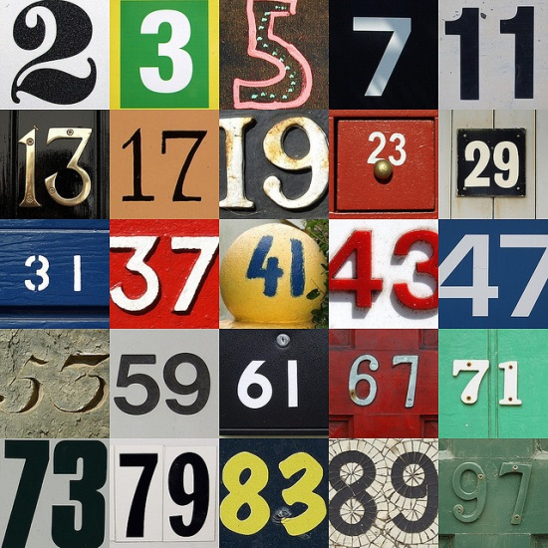
Keep an eye on the numbers & focus on key metrics
Examples of how to set up revenue forecasts

Slide 52
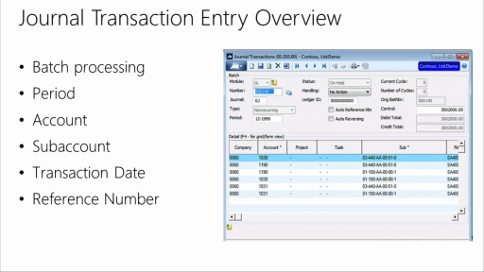
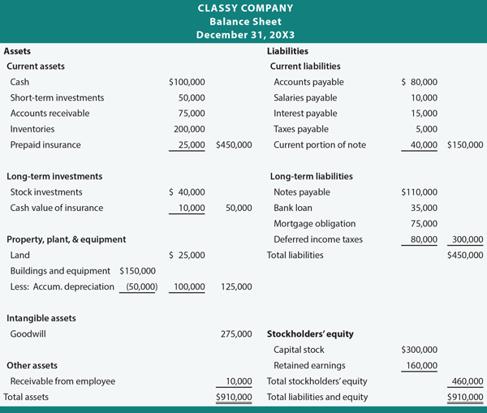
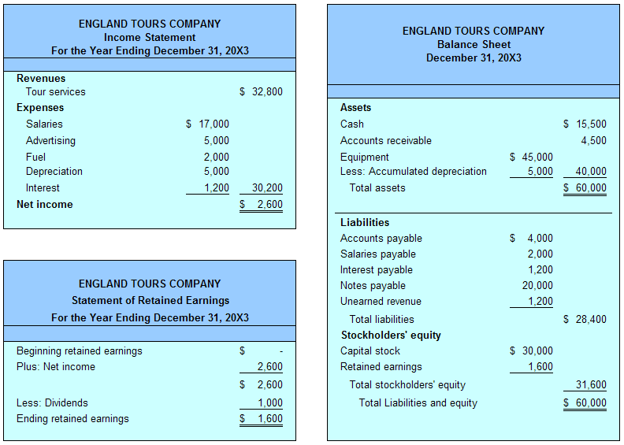
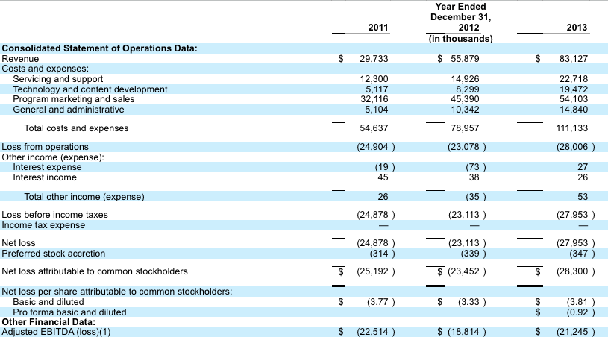
Financials – The Numbers

Slide 53
Financial Statements
Income Statement The income statement shows whether the difference between revenue (sales) and expenses (costs) is a profit or a loss over a given time period
Balance Sheet A balance sheet is a financial statement that shows the assets (what the business owns), liabilities (debts), and the net worth of a business. The net worth is the difference between assets and liabilities and is also called owner’s equity
Cash Flow Statement transaction records—such as those kept in a journal or check register—will show the cash balance on hand.
Notes:
Freelancer’s Café offers a good example.

Slide 54
Seed Capital: one-time expense of opening a business
Include a reserve for funding operations until cash is generated as well as the costs of starting your business
.
Start-up capital plus any money you or others have in-vested in the business (excluding loans) is not part of the P/(L)

Slide 55
P/(L) - Variable VS Fixed Costs
Variable Costs – expenses that vary directly with changes in production or sales volume
Cost of Goods Sold (COGS) or Cost of Services Sold (COSS)
  The cost of materials used to make the product (or deliver the service).
  The cost of labor used to make the product (or deliver the service).
Other variable costs:
  Commissions or other compensation based on sales volume.
  Shipping and handling charges.
Fixed Costs – expenses that must be paid whether or not sales are being generated
Examples include Utilities, Salaries, Advertising, Insurance, Interest, Rent, Depreciation (USAIIRD) and professional fees

Slide 56

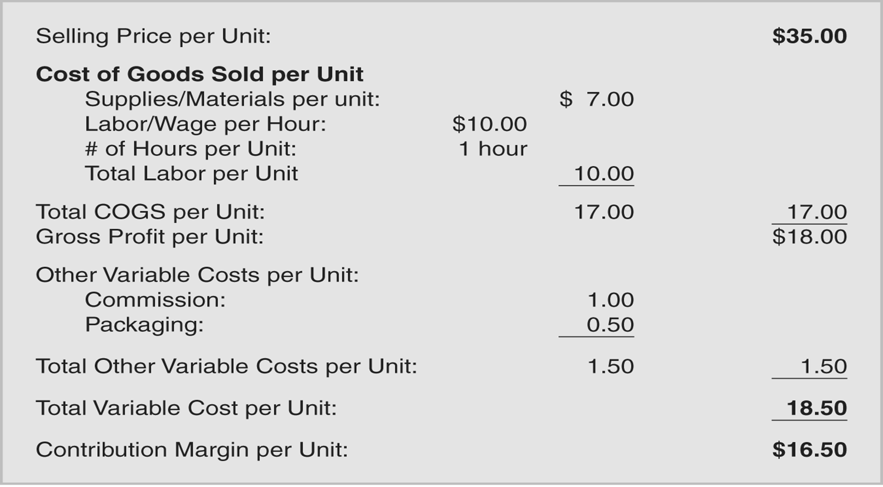
Economics of One Unit (EOU) Analysis
Notes:
Watch out for units. Advertising is a FIXED cost.

Slide 57



Economics of one Unit – Class Exercise
David is considering charging $12.00 for a large pepperoni pizza.
Use the following information to calculate his economics of one unit
Notes:
http://www.alanisbusinessacademy.com/theeconomicsofoneunit/

Slide 58
Economics of One Unit (EOU) Analysis
Trick for making sure you calculate unit costs correctly
Item | Unit Requirement | Price/Amount | Calculation | Price/Unit
Pizza Sauce | 8 oz.. | $ 10.00/ package (60 oz.../ package) | $10.00 x 1 package x 8 oz.. package 60 oz.. unit | $1.33/unit
Cheese | 16 oz.. | $ 15.00/ 48 oz... | $15.00 x 16 oz... 48 oz... unit | $5.00/unit
Pepperoni | 4 oz.. | $ 8.00/ 16 oz... | $ 8.00 x 4 oz... 16 oz... Unit | $2.00/unit
Pizza Dough | 32 oz.. | $ 20.00/ 80 oz... | $ 20.00 x 32 oz... 80 oz... Unit | $8.00/unit
Direct Labor | 6 min | $8.00/hour | $8.00 x hour x 6 min. hour 60 min. Unit | $0.80/unit
 |  | Total Cost of Goods Sold CGS)/Unit |  |  | $17.13/unit
Pizza Box | 1 box | $25.00/pack (50/pack) | $25.00 x pack x 1 box pack 50 boxes unit | $0.50/unit
Stacker | 1 stacker | $20.00/1000 stackers | $20.00 x 1 stacker 1000 stackers unit | $0.02/unit
 |  | Total Other Variable Costs/Unit |  |  | $0.52/unit
 |  | Total Variable Costs/Unit |  |  | $17.65/unit
 |  | Selling Price/ Unit Minus the Total Variable Costs/Unit EOU |  |  | $12.00 ($17.65) ($ 5.65)
Notes:
What are David’s options
Cut costs or brand himself differently
Gross Margin -$5.13

Slide 59
Cash is King
There is often a time lag between making a sale & getting paid. .
A company may show a profit and have a negative cash flow; cash and profit are not the same.
Cash flow statement- financial document that tracks the money coming into and going out of an organization.

Slide 60
Tips for Conserving Cash
Collect cash as soon as possible
Pay your bills by the due date, not earlier
Check your available cash daily
Lease or finance instead of buying equipment where practical.
Avoid buying inventory or items that isn’t critical (Lean Startup)
Avoid paying in cash maintain a paper trail so you have good records
Prepare for cash flow cycles
Notes:
Some examples of cash flow cycles?

Slide 61
Burn Rate
(Cash Available + Revenue ) = Number of Months
Negative Cash Outflow per Month before Cash Runs Out
The pace at which a company spends capital before generating positive cash flow.

Slide 62
Homework for Wed., March 11 – 4th Team Presentation
How do you plan to make money from your business?
What are the important metrics and milestones?
Seed capital required
Financial Statement and estimate of when business will breakeven

Slide 63
Homework for Wed., March 11 – 4th Team Presentation
Guidelines for the financial statements
  Income statement (before tax) only showing fixed and variable costs
  Emphasis on revenue assumptions and metrics
  Time period - Monthly or quarterly until you break-even
  Don’t worry about when the money is collected or spent (i.e. no cash statement)
  Show depreciation as a periodic $$ cost (i.e. as if it were leased)
  No balance sheet or cash flow statement

Slide 64
Homework for Wed., March 11 – 4th Team Presentation
Evaluation questions will pertain to clarity, feasibility, whether you captured the important cost elements and if the operation is lean (conserving cash)
Notes:
For example

Slide 65
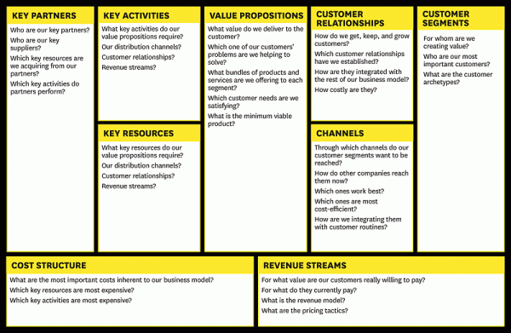
Business Model Canvas

