Slide 1
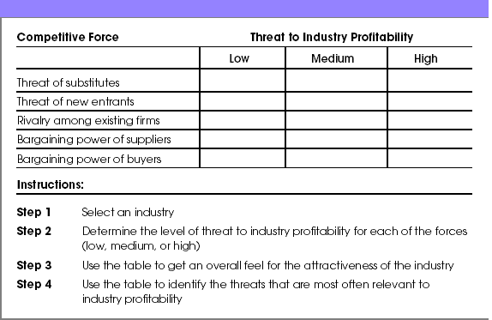
First Application of the Five Forces Model 2 of 2
Assessing Industry Attractiveness Using the Five Forces Model

