Slide 1
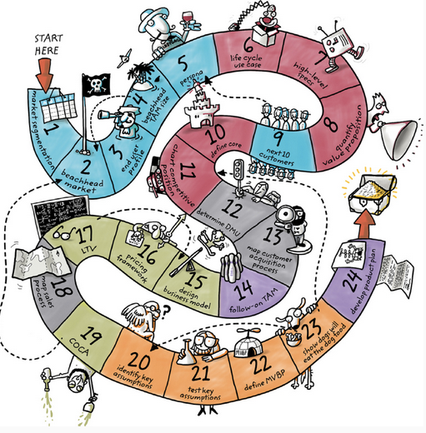
Homework for Wednesday May 20
Finish reading “Disciplined Entrepreneurship
Read and answer the questions below in a few sentences: “Culture Eats Strategy For Breakfast” http://techcrunch.com/2014/04/12/culture-eats-strategy-for-breakfast/ Why is culture important? I Thought Facebook's WhatsApp Deal Was Crazy. Then I Did Some Math. http://www.wsj.com/articles/SB10001424052702304834704579403012327306216 Do you think Facebook overpaid for WhatsApp? How dreams and money didn’t mix at a Texas Distillary http://www.nytimes.com/2014/12/28/business/how-dreams-and-money-didnt-mix-at-a-texas-distillery.html?emc=edit_th_20141228&nl=todaysheadlines&nlid=1022838&_r=1 What are some of the problems bringing in new investors?
“Disciplined Entrepreneurship: 24 Steps to a Successful Startup”

