Slide 1
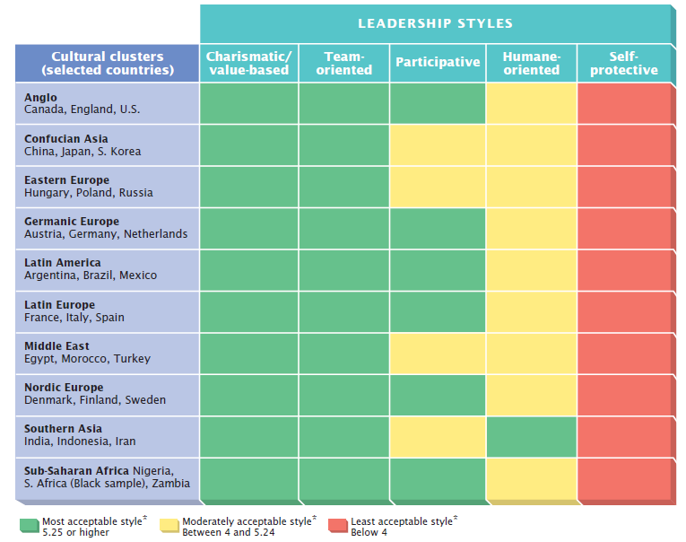
Figure 4.1: GLOBE Leadership Matrix
© 2013 Cengage Learning. All Rights Reserved. May not be scanned, copied or duplicated, or posted to a publicly accessible website, in whole or in part.

